Slide 1
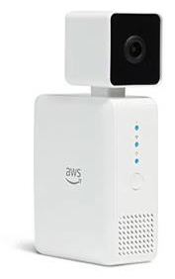









DeepLens
Appian
Customer Record
Customer Visit Record
Face Detected in frame
Task Queue
5. Appian WebAPI call
Process Server
1. Call rekognition.detect_faces because may be more than on face in frame – this returns set of bounding boxes
AWS S3
Deeplens Bucket
Bucket triggers Lambda
6. If RekognitionID NOT FOUND in “customer_rekognition_collection” then it means can’t find a “known person”. In this case, log to history table as “unknown” person and publish to SNS topic – thereby only sending alerts for unknown people to SN S.
Customer Face Analysis Function
AWS S3
Deeplens Bucket
2. For each bounding box returned, call rekognition.search_face_by_image – this returns a Rekonition ID for the image
Post message and unknown person image URL to topic
3. Lookup rekonitionID in Dynamo DB table “custome_rekonition_collection” to retrieve name for this person
4. Store the matched RekognitionID and Name in another Dynamo DB table called Customer_facial_History, which is complete history of everyone who’s ever come to the bank
Unknown Person detected! Send sms to Sales person to view the image
SNS Topic

